Slide 1
Designathon 2023
Multi-tool Challenge
Team 18: Ibrahim, Alex, Tabish, Ryan

Slide 2
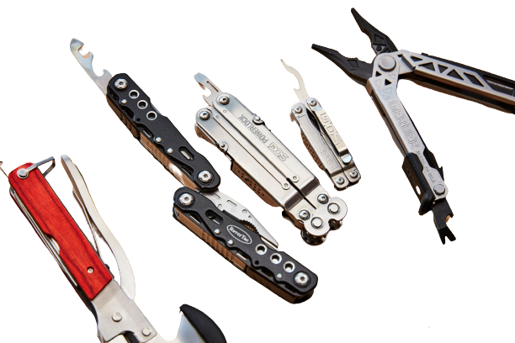

Problem slide
Multiple tools = INCONVENICE
Solution?
Create a multitool!
Oversaturation?
Now what?
Multitool
Niche
Eureka!

Slide 3
Solution Criteria
Multitool for computer maintenance
Safe and compact
Customizable
Utility
Features and Specifications
Interchangeable Screwdriver
Needle Nose Plier
Sim Ejector
4 inch ruler
Scissors
Jimmy
8 in x 4 in x 4 in
¼ inch driver hex
Bit size variation
Small
Medium
large

Slide 4
Reason we chose what we chose slide

Slide 5
Design Process slide

Slide 7

Final 3D Model

Slide 8



Simulation of Mechanisms

Slide 9

User interface and choice of aesthetic

Slide 10
Design Feasibility

Slide 11

Economic Analysis and BOM

Slide 12

Future Innovations

Slide 13

Conclusion

Slide 14
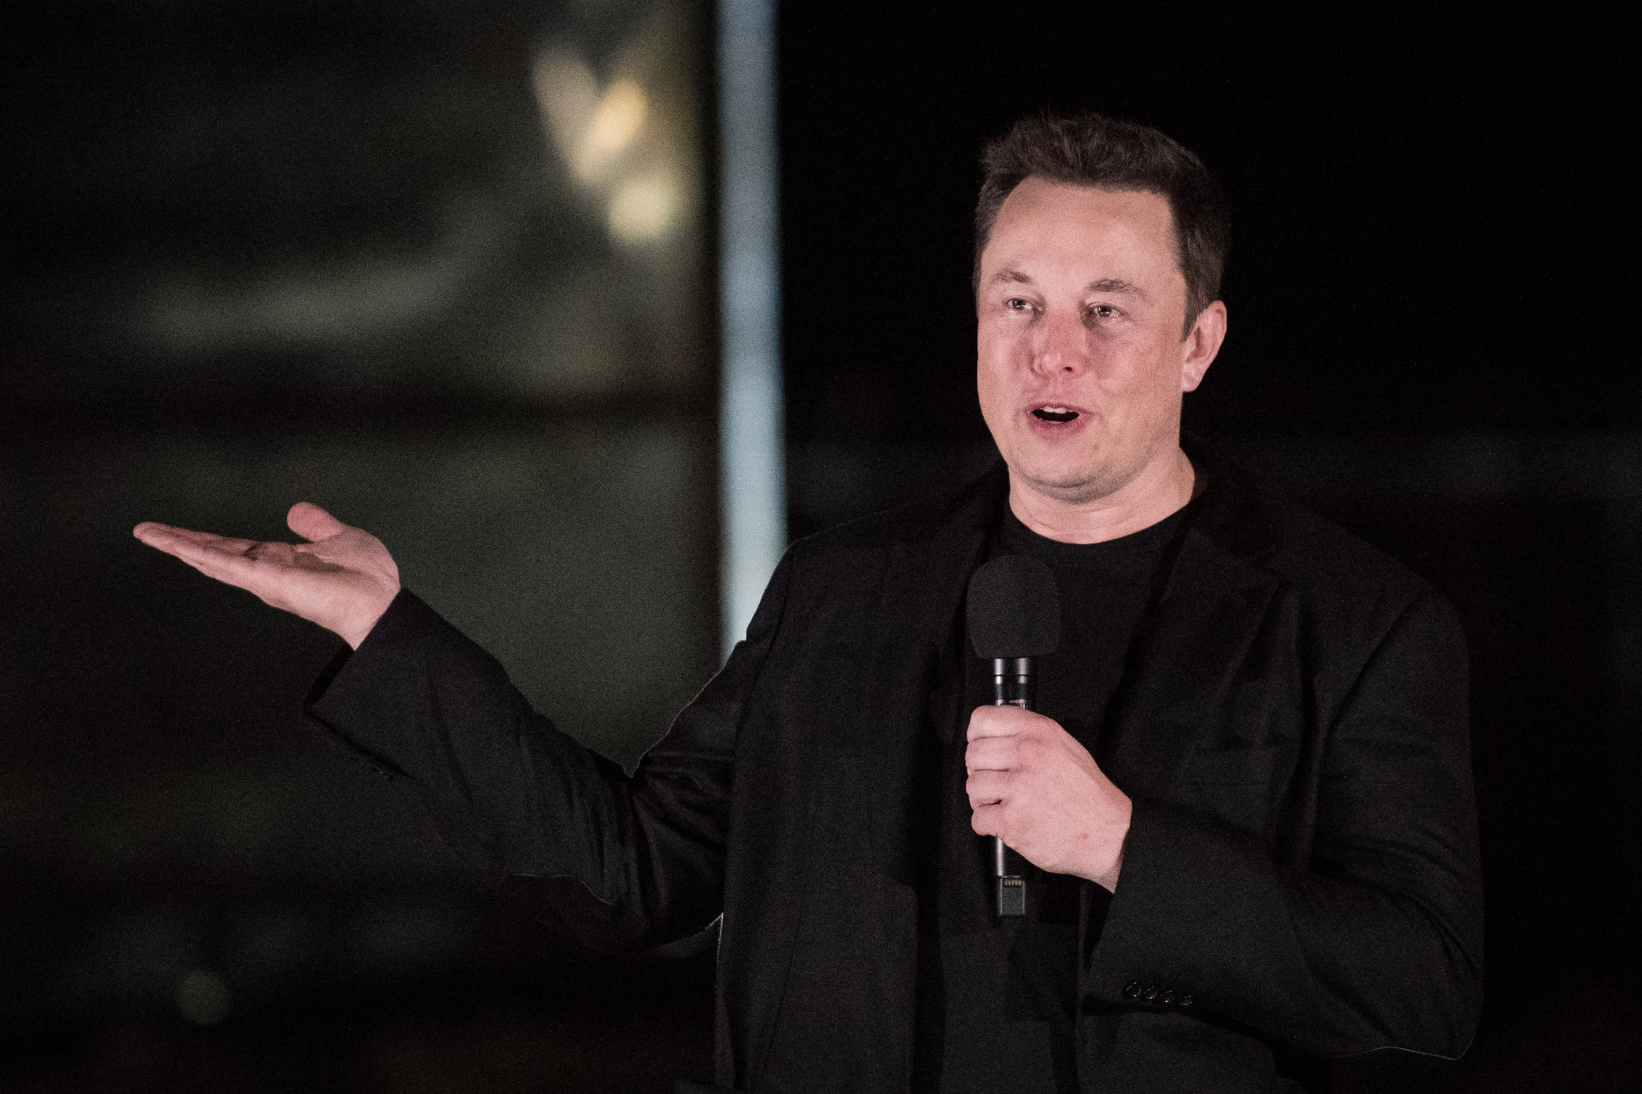
The End
Notes:
ELON MUSK APPROVED
Thank you for listening.

